Slide 1
Lab 4
MEG Source level analysis

Slide 2
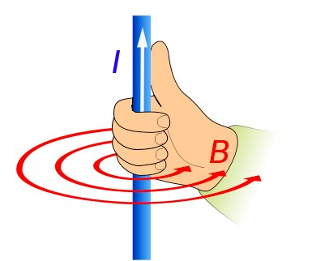
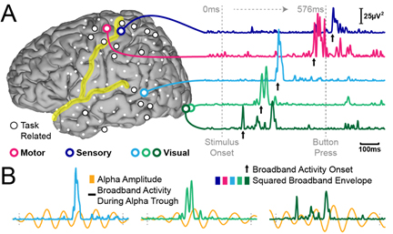
EEG vs MEG the differences and similarities

Slide 3
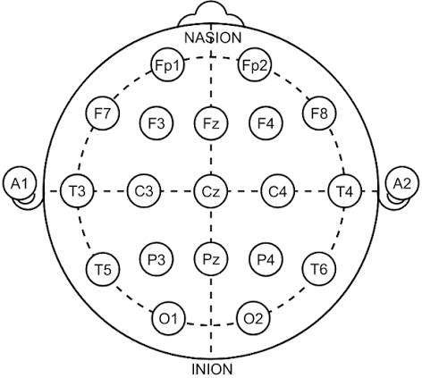
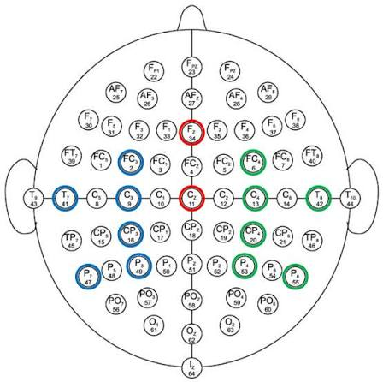
EEG configuration setup

Slide 4
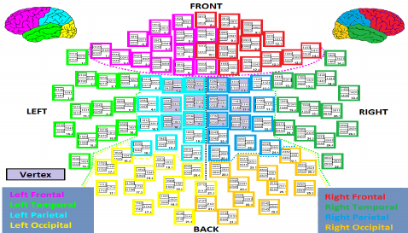

Slide 5
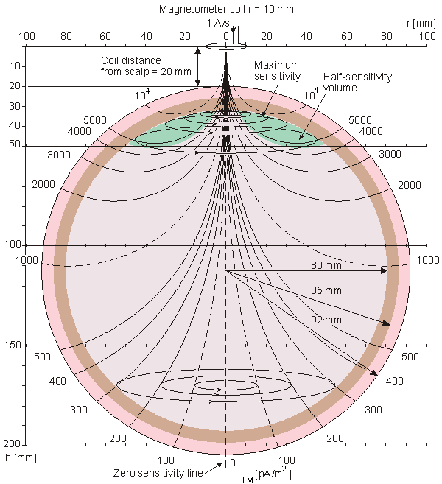
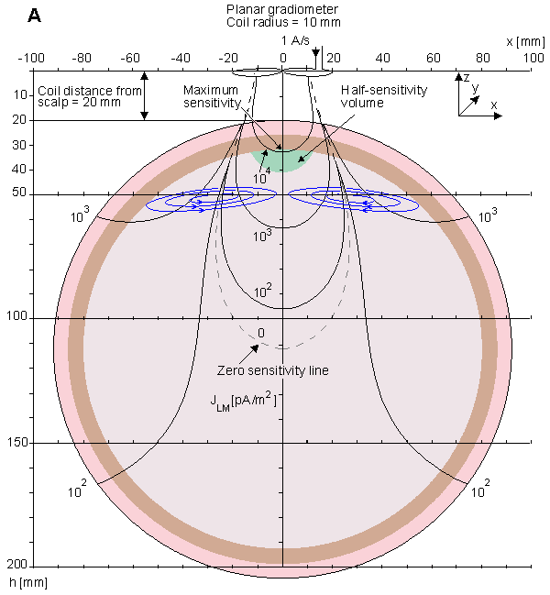
Total magnetic field (T))
Field gradient (T/m

Slide 6
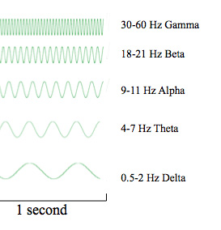
Waves and their meanings
Delta (0.1–4 Hz): Deep, dreamless sleep and unconscious processing — the brain's "1st gear."
Theta (3.5–7.5 Hz): Creativity, intuition, daydreaming, and the drowsy border between wakefulness and sleep.
Alpha (8–12 Hz): Calm, relaxed alertness that bridges conscious and subconscious thought — the brain's "neutral" gear.
Beta (13–30 Hz): Active, analytical thinking, focus, and alert problem-solving — the brain's "overdrive."
Gamma (>30 Hz): High-level simultaneous processing linked to sharp memory and peak cognitive integration.

Slide 7
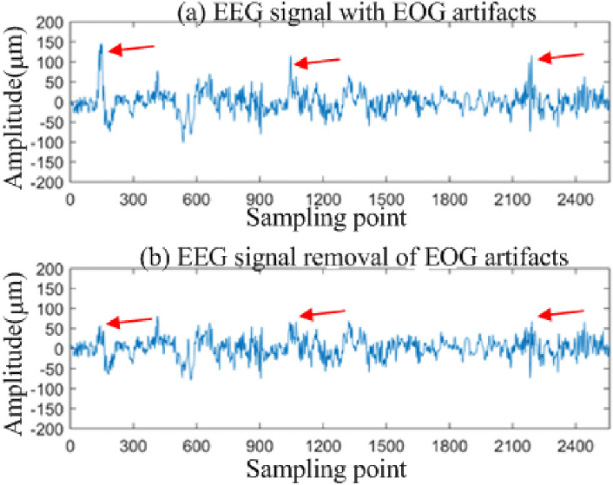
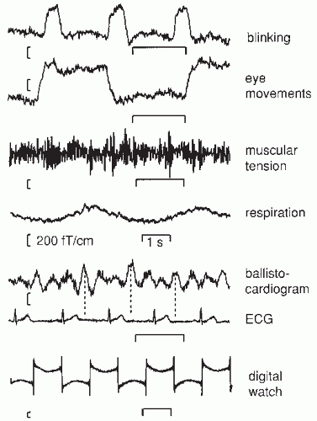
Artifacts

Slide 8
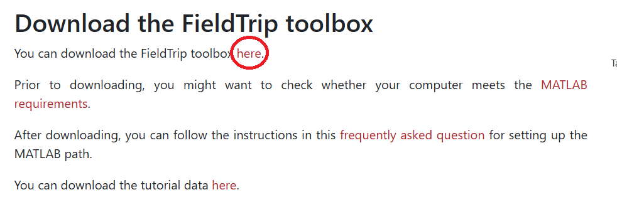
Lab today
Run through the code.
Understand your inputs the formats and what they mean.
Learn the basic technics on how to do basic processing.
Doing some source level analysis.

